Slide 1
LOADING...

Slide 2
Please remember
NDA slide from Chris!

Slide 3
Project X
EARLY GAME DEVELOPMENT
DATA ANALYSIS

Slide 4
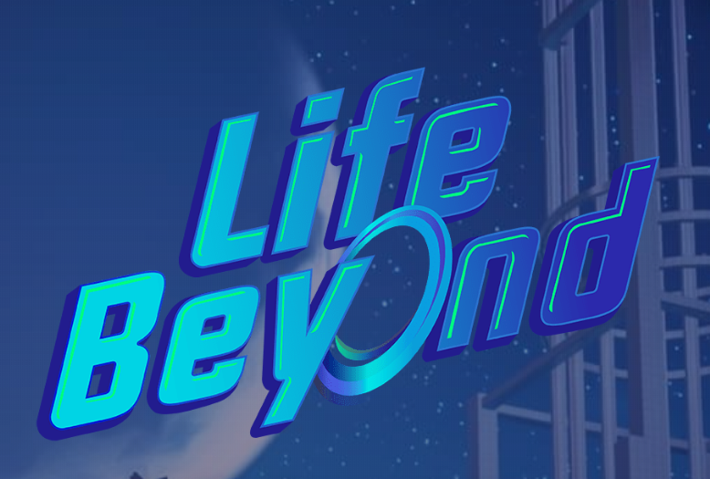
Life Beyond developed by Darewise Entertainment
(alpha version released in late 2019)

Slide 5


Slide 6
Scenario:
Darewise is a young gamedev studio.
Life Beyond recently entered alpha testing and lacks data analysis. CEO wants to have as much insights from what they have as possible.
Added value to game designers and everyone involved.

Slide 7
Objectives:
Get as much data as possible
Explore and analyze everything in Life Beyond
Visualize insights and useful findings

Slide 8
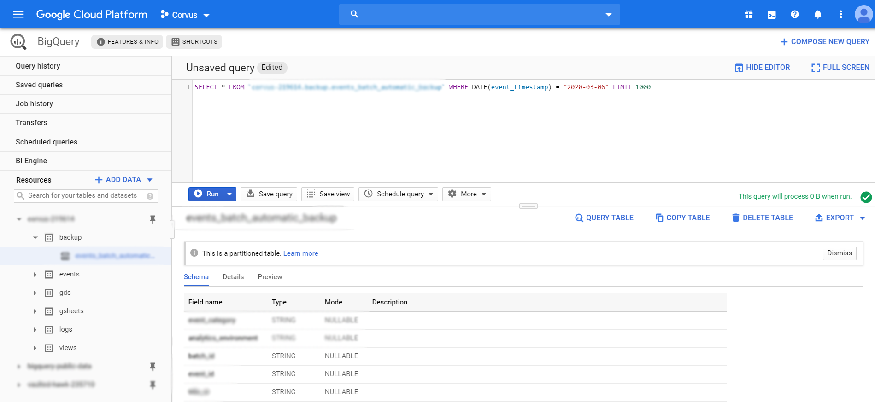
Data collection
Data generated by game engine, processed by Microsoft Azure PlayFab, stored in Google Cloud within BigQuery
Python connection to BigQuery
Unwrapping and cleaning

Slide 9
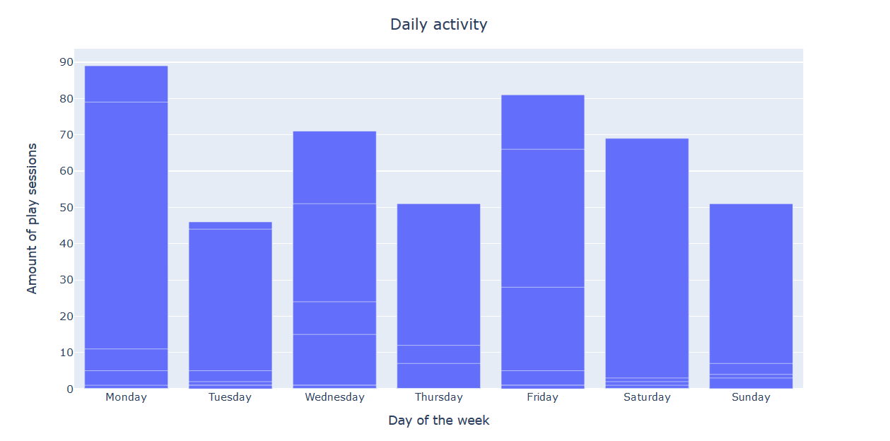
Data visualization

Slide 10
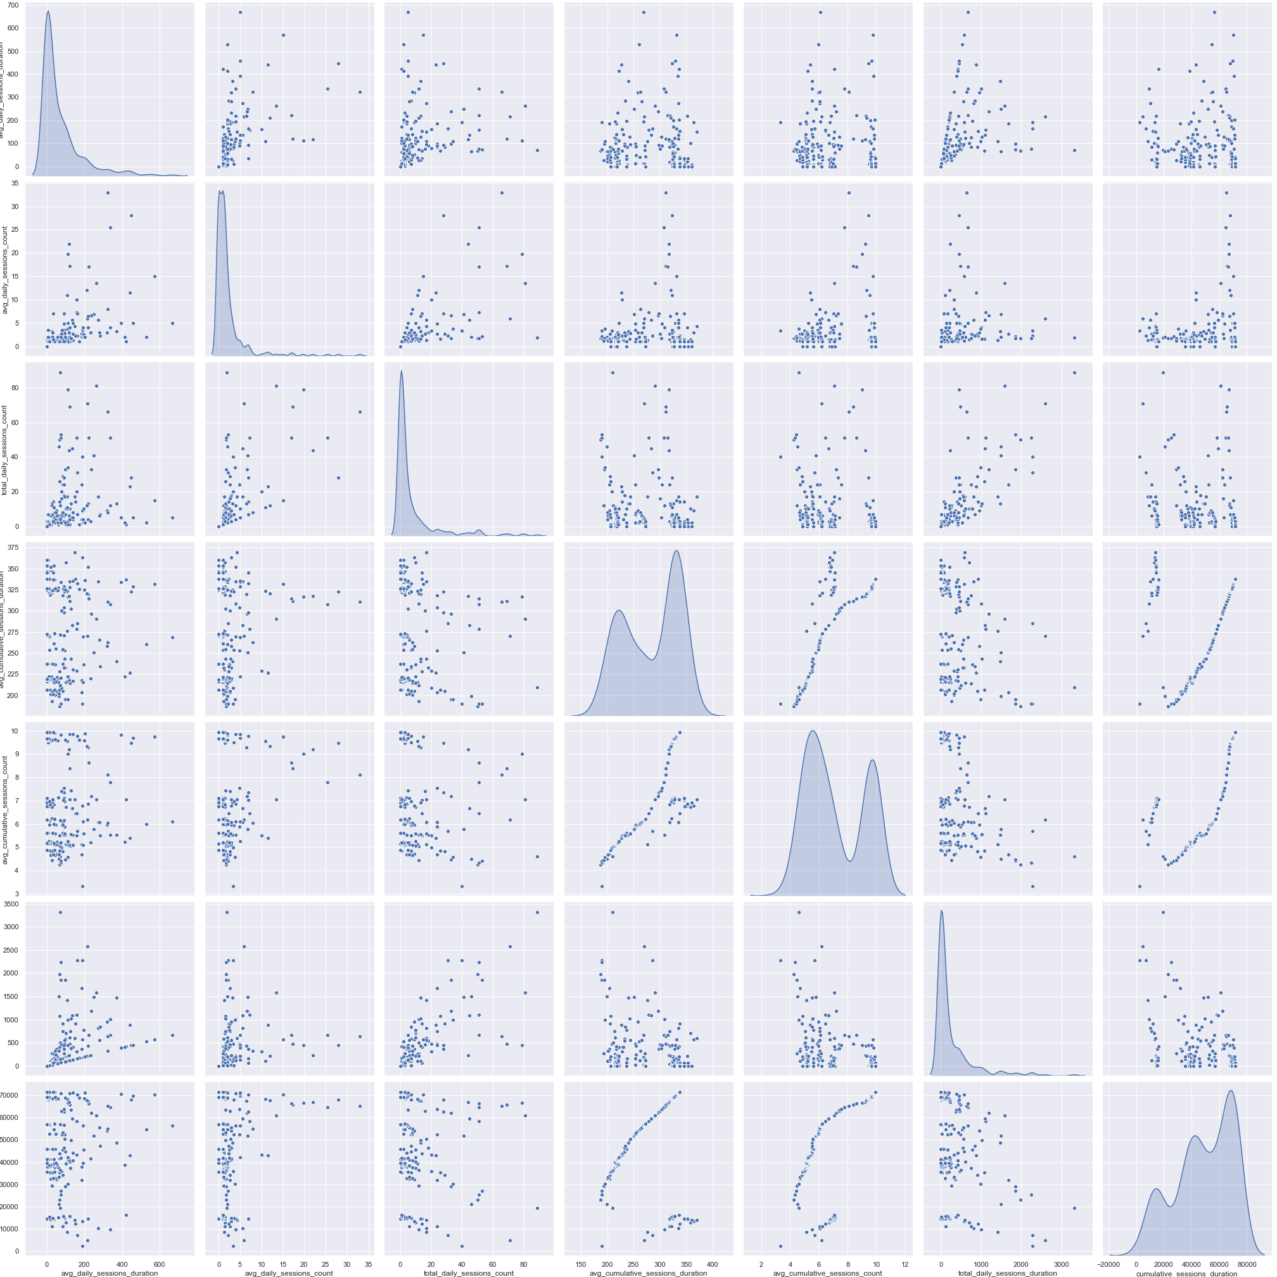

Slide 11
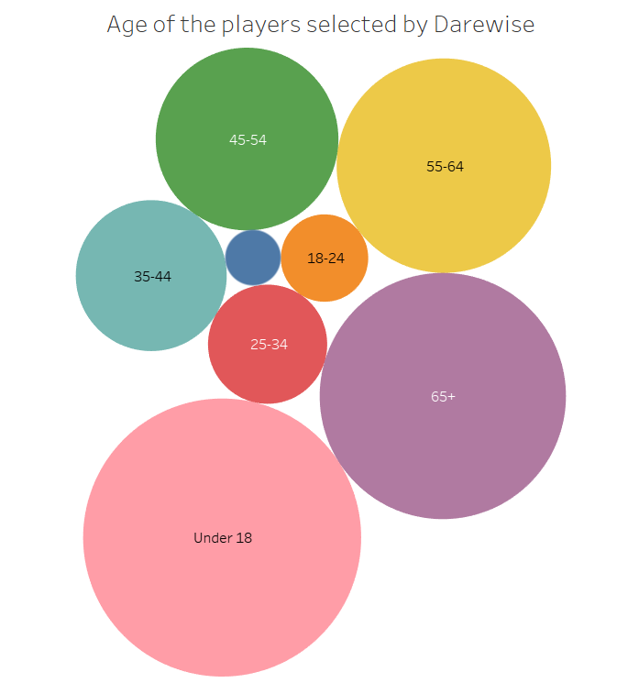
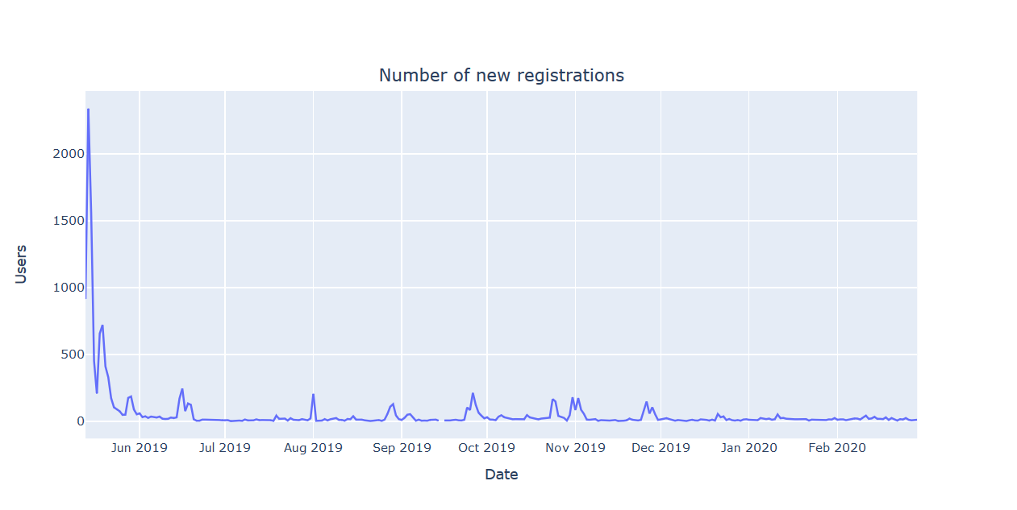
Data visualization

Slide 12
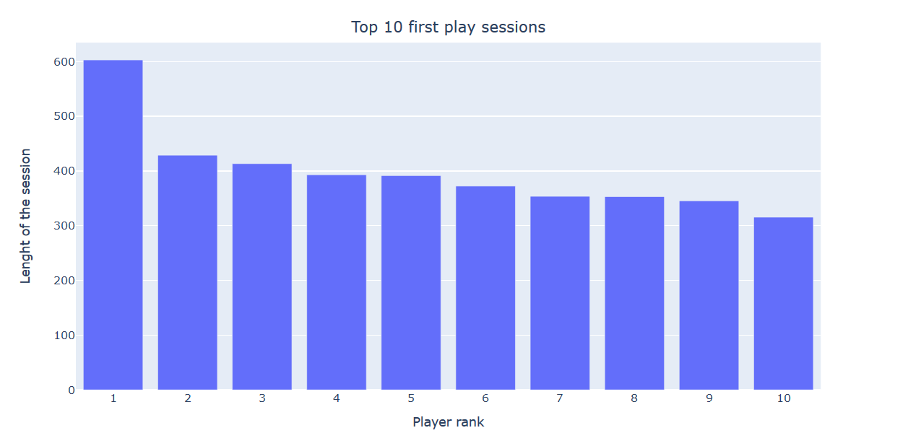
Data visualization

Slide 13
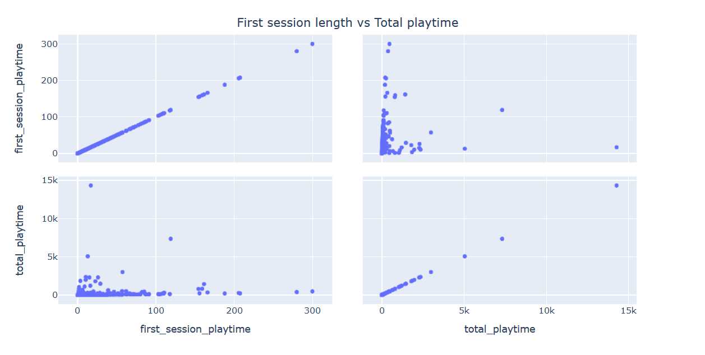
Data visualization

Slide 14
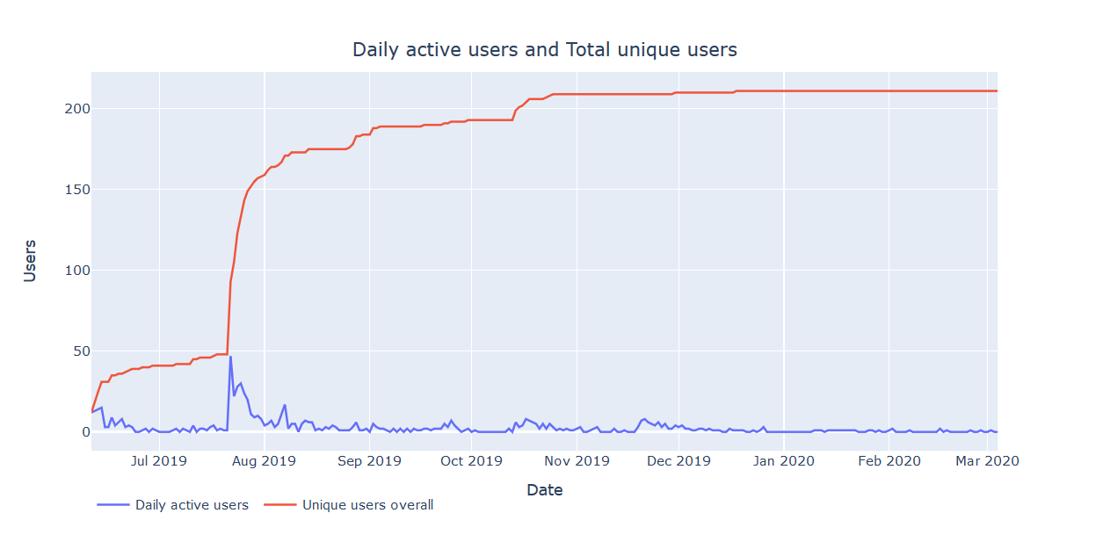
Data visualization

Slide 15
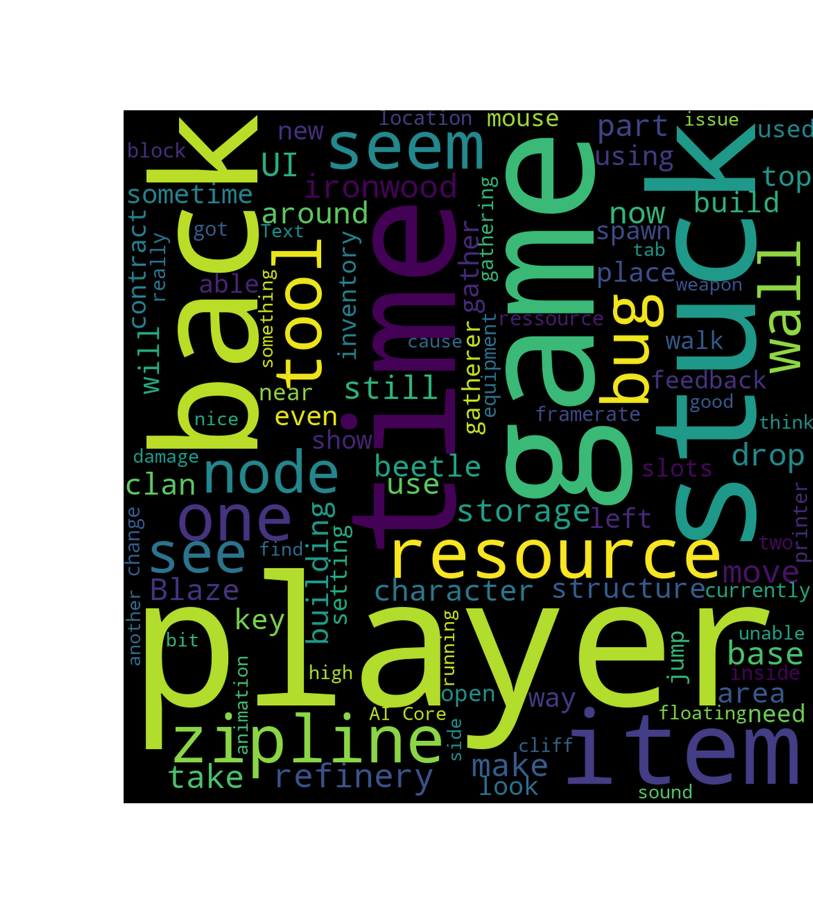
Top 100 words
used by players
in their feedback

Slide 16
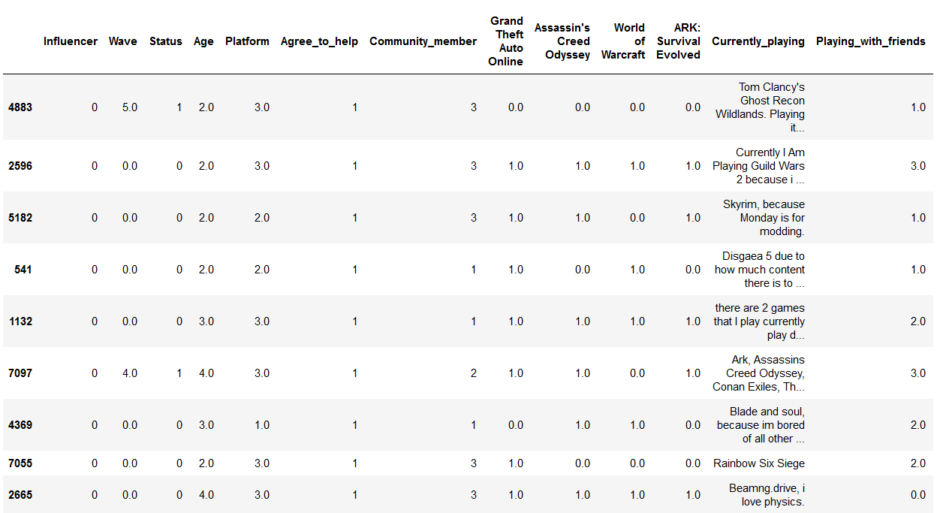
Data cleaning
JSON normalization hell
Lack of meaningful data from inside the game
Missing data descriptors

Slide 17
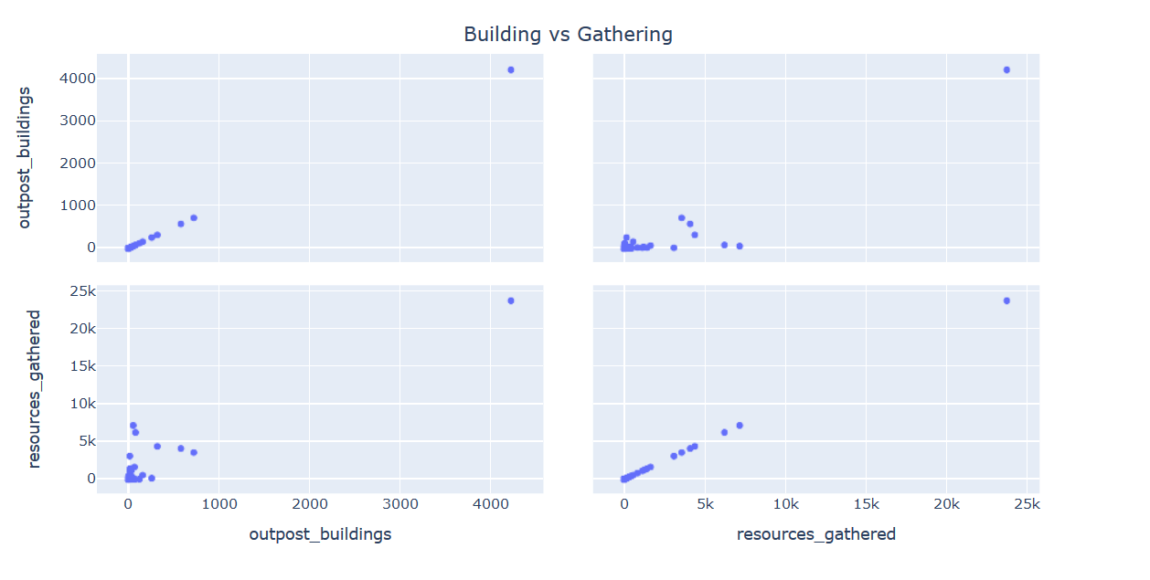
More data visualization

Slide 18
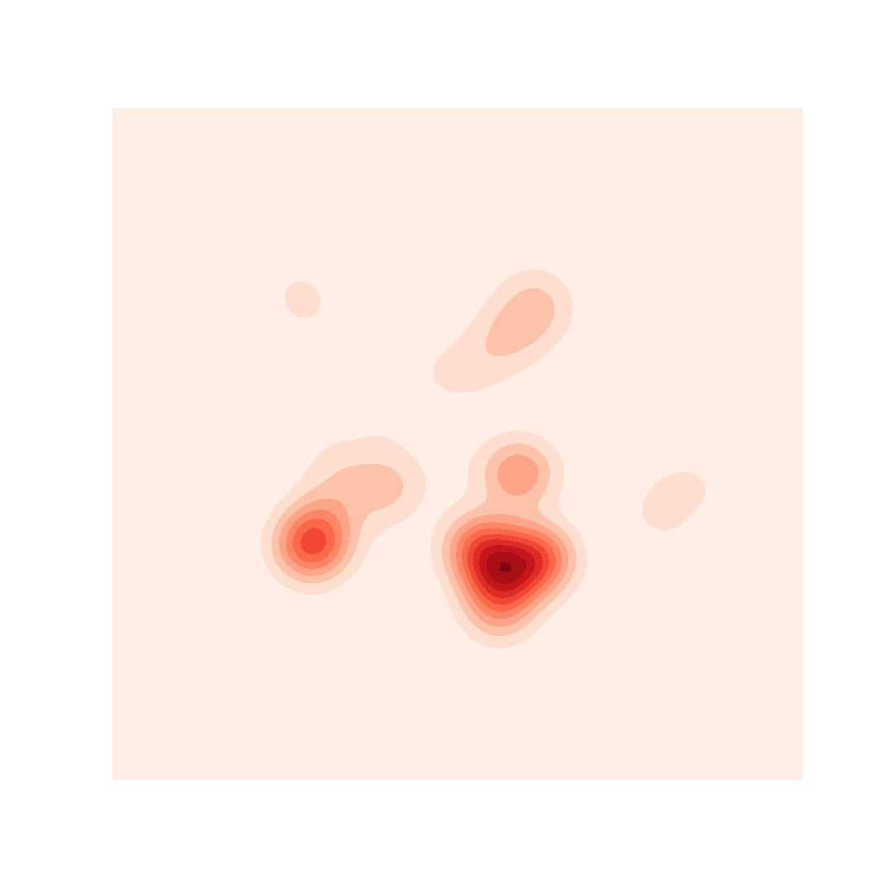
Heatmap
(players actions
defined by XY coords
in coordinates set_1)

Slide 19
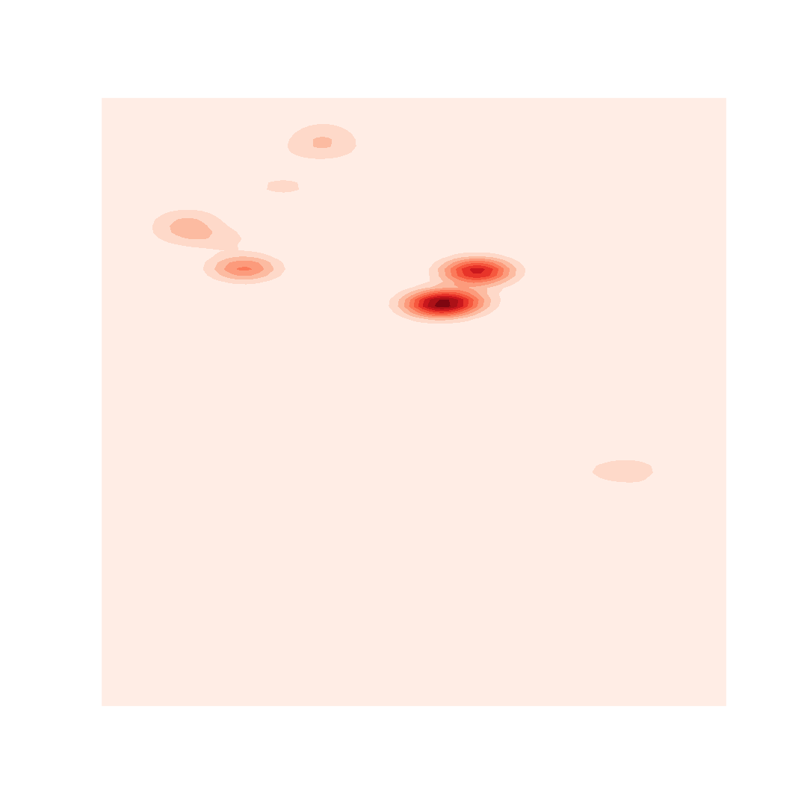
Heatmap #2
(players actions
defined by XY coords
in coordinates set_2)

Slide 20
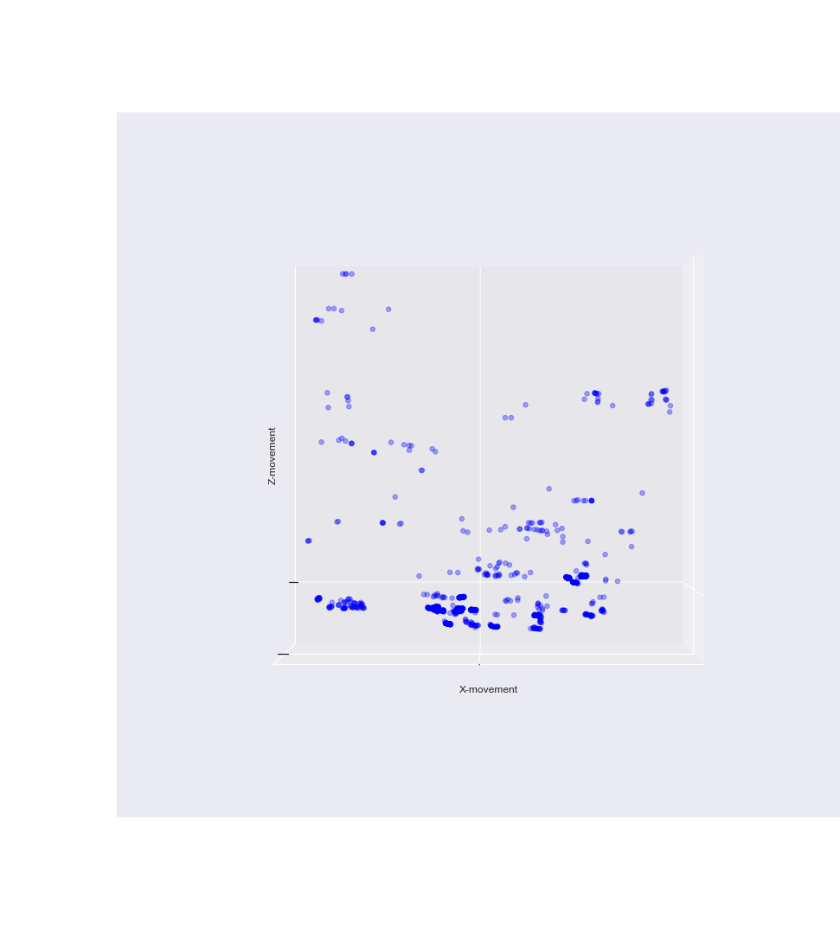
3D plot of players actions
XZ axes
coordinates set_1

Slide 21
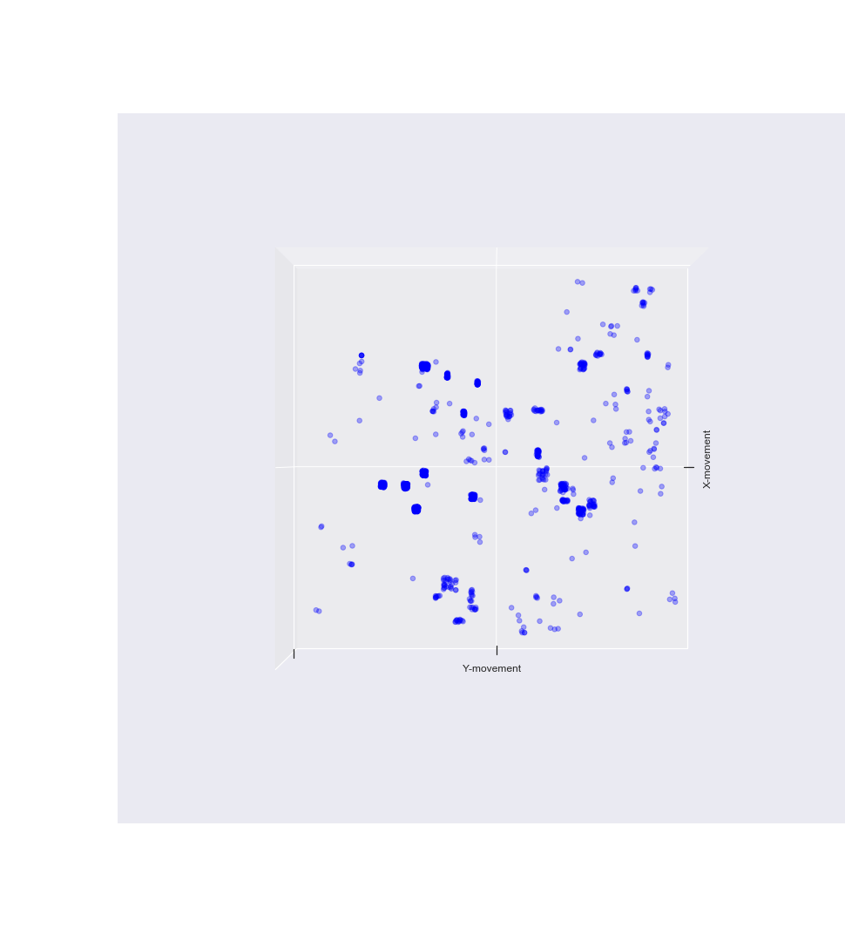
3D plot of players actions
XY axes
coordinates set_1

Slide 22
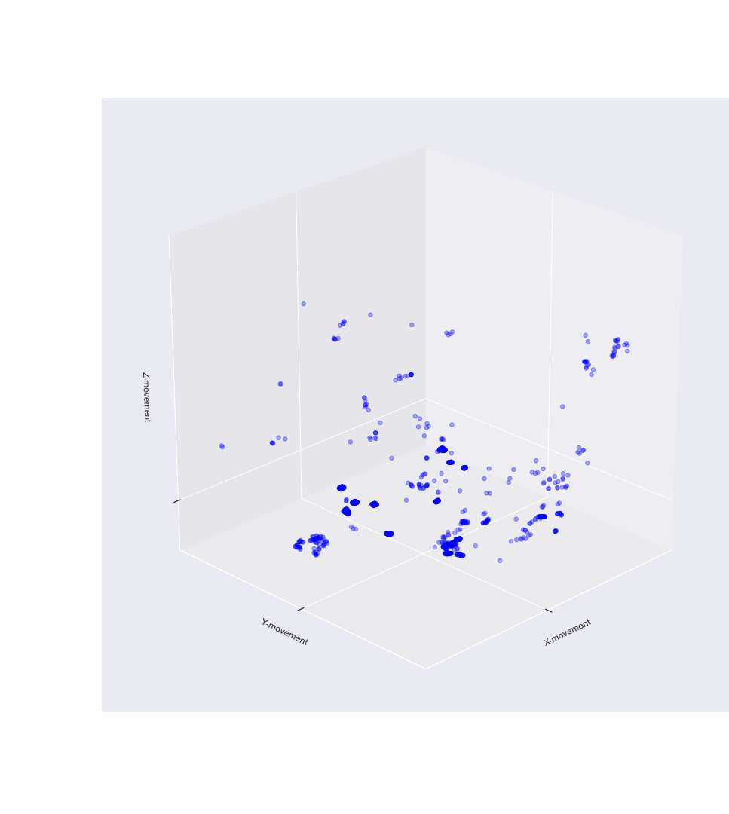
3D plot of players actions
XYZ axes
coordinates set_1

Slide 23
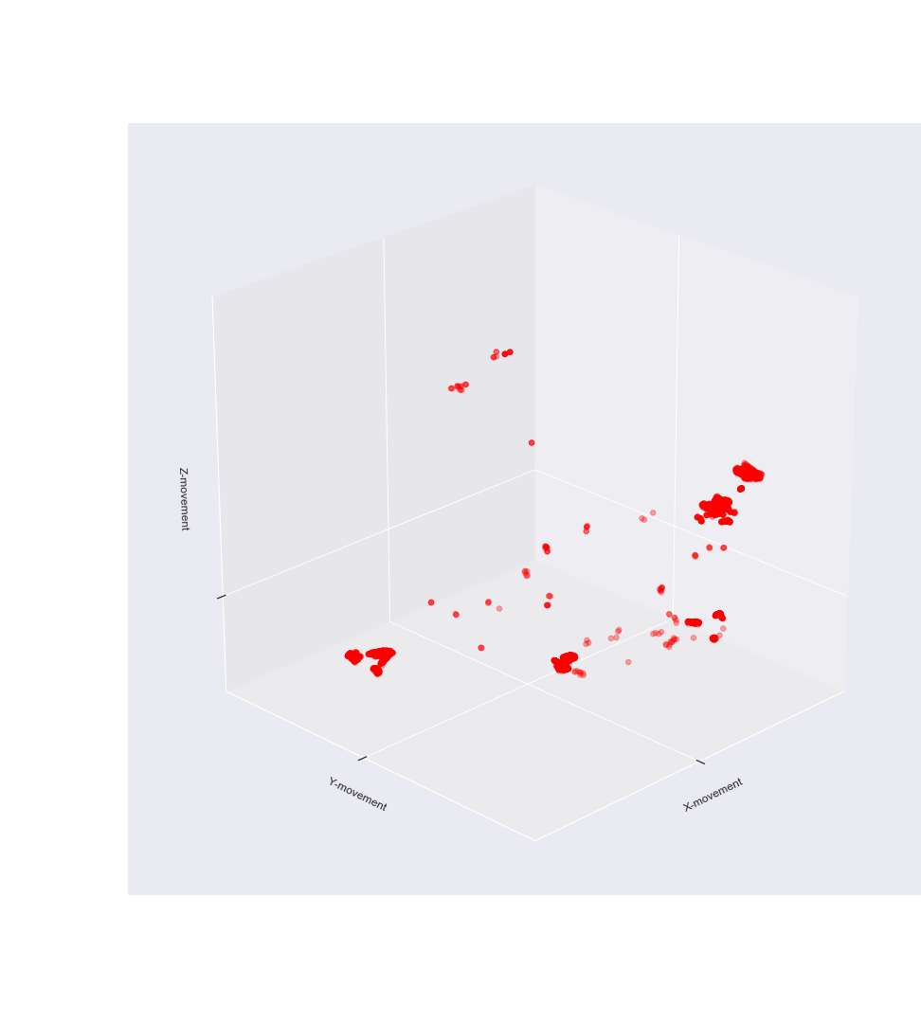
3D plot of players actions
XYZ axes
coordinates set_2

Slide 24
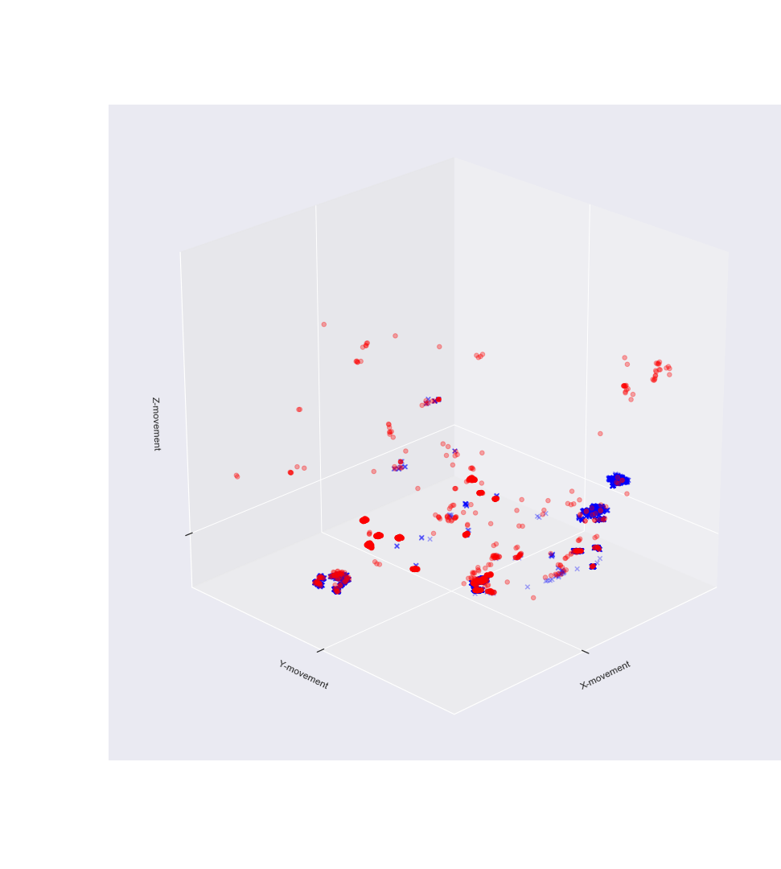
3D plot of players actions
XYZ axes
two coordinate sets compared

Slide 25

Models

Slide 26
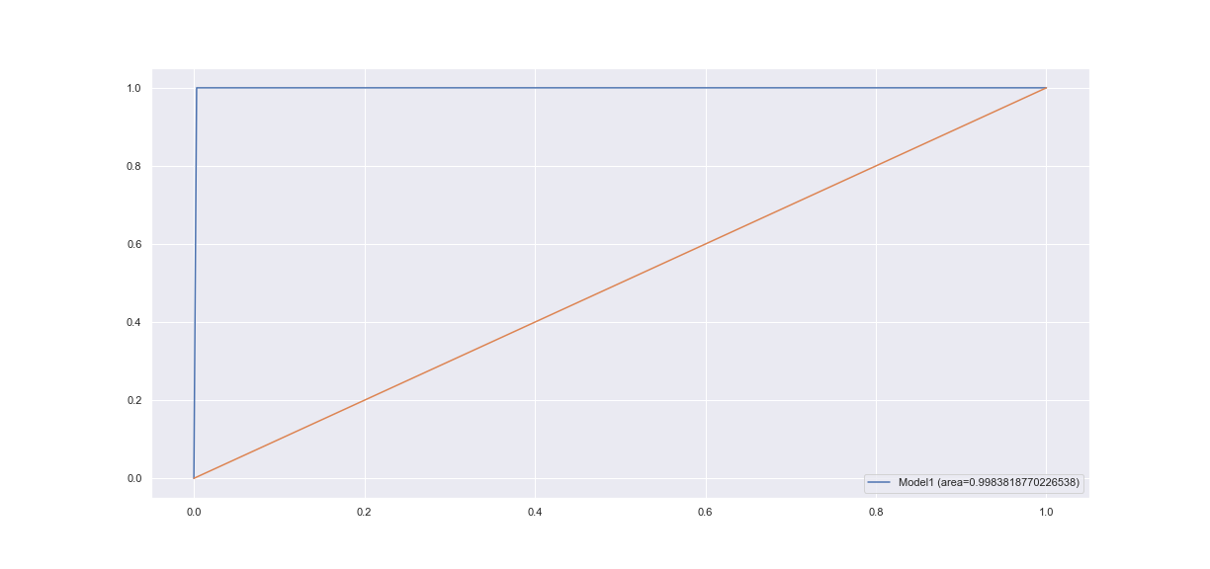

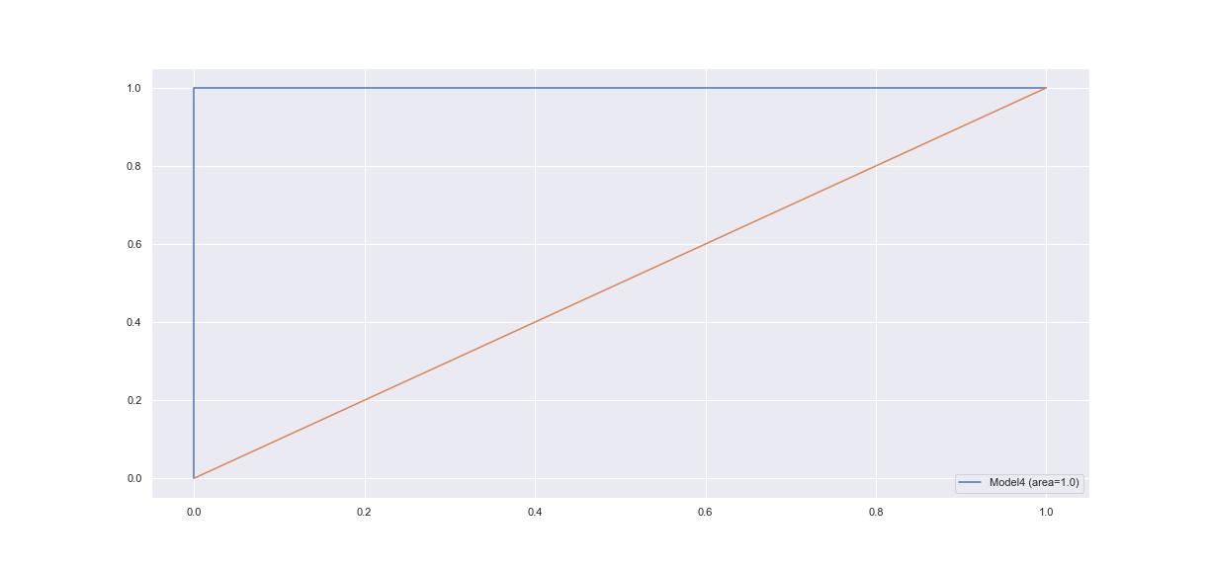


Models - predict if player is going to provide feedback

Slide 27
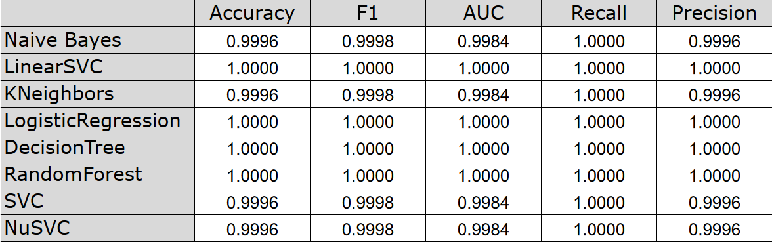
Accuracy stats overview

Slide 28
Summary and lessons learned
Kaggle is a “perfect scenario” for getting data. Real life cases are not.
Data that will be recorded needs some ideas put into it beforehand.
Darewise would be wise to go ahead with expansion of its data recording force. Insights come from a meaningful data, and the sooner collection of such things is implemented, the better developers would be able to understand their players.
Explore the possibilities of fixing deeply nested data from UnrealEngine
Find more data to make Supervised ML more efficient
Unsupervised ML
Move on sooner

